Slide 1




Test Automation with Selenium WebDriver
Selenium Introduction, Record Actions, Use Selenium API in Java
QA
Fundamentals
Ivan Yonkov
Training Lead
Software University
http://softuni.bg

Slide 2

Table of Contents
Test Automation Introduction
Selenium Introduction
Selenium IDE
Recording a Firefox Action
Exporting Test Cases
Using Selenium WebDriver Java API
  Select Elements
  Send Keys
  Assertions

Slide 3

Automat…ion

Slide 4
What is Test Automation?
Executing repetitive but necessary tasks
  Login, registration, etc…
Comparing the actual and expected outcomes
  Checking visual result
  Checking api responses
Adding a test to difficult to perform manual actions
  Big scenario e.g. login the user, then add some products to cart, then check database, then checkout the cart, etc…

Slide 5

Selenium

Slide 6
Introduction to Selenium?
Framework and a tool for web automation
Consists of two components
  Selenium IDE – record/playback tool for Firefox
  Selenese – A domain-specific language
  Selenium WebDriver – API For most of the popular languages

Slide 7
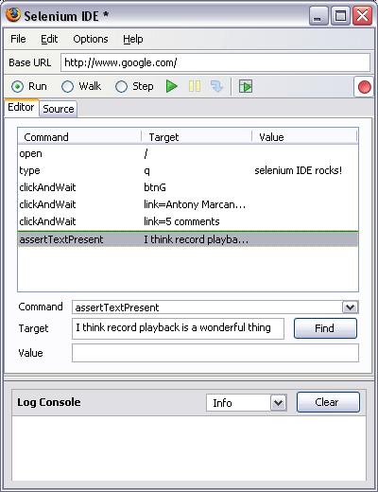
Selenium IDE

Slide 8
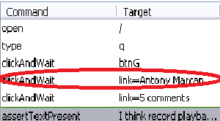
Selenium IDE (2)
Recording actions
Using selectors/xpath for interaction
Has basic own api for various actions (click, wait, select, etc..)

Slide 9
Selenium IDE - Live Demo

Slide 10

Selenium WebDriver
Library for automating scripts in various languages (Java, C#, Ruby, Python, PHP…)
Uses unit testing engine for a lot of the core actions
Has API for all web-browser actions a user can do

Slide 11

Selenium WebDriver API

Slide 12
Selenium WebDriver API (2)
Maven dependencies
<dependency>
<groupId>org.seleniumhq.selenium</groupId>
<artifactId>selenium-java</artifactId>
<version>2.45.0</version>
</dependency>

Slide 13
Selenium WebDriver API (3)
Setup a test class
public class MyTest {
private WebDriver driver;
private String baseUrl;
private boolean acceptNextAlert = true;
private StringBuffer verificationErrors = new StringBuffer();
}

Slide 14
Selenium WebDriver API (4)
Setup an initializer
@Before
public void setUp() throws Exception {
this.driver = new FirefoxDriver();
this.baseUrl = "http://application.to.test.com";
this.driver
.manage().timeouts().implicitlyWait(30, TimeUnit.SECONDS);
}

Slide 15
Selenium WebDriver API (5)
Click on an element
  Find the element – findElement()
  Use a certain selector – The “By” class
  Perform an action – click()
this.driver
.findElement(By.id(“submit-btn")).click();

Slide 16
Selenium WebDriver - Live Demo

Slide 17
Summary
  Test automation theory
  Selenium IDE – record, play, export case
  Selenium WebDriver – using Java Library with Maven and JUnit to automate a simple scenario
  The findElement() method
  The By static class
  Selector methods

Slide 18








Test Automation Introduction
http://softuni.org/courses

Slide 19
License
This course (slides, examples, demos, videos, homework, etc.)
is licensed under the "Creative Commons Attribution-NonCommercial-ShareAlike 4.0 International" license
Attribution: this work may contain portions from
  "ASP.NET MVC" course by Telerik Academy under CC-BY-NC-SA license

Slide 20





Free Trainings @ Software University
Software University Foundation – softuni.org
Software University – High-Quality Education, Profession and Job for Software Developers
  softuni.bg
  Software University @ Facebook
  facebook.com/SoftwareUniversity
  Software University @ YouTube
  youtube.com/SoftwareUniversity
  Software University Forums – forum.softuni.bg

